Slide 1
DI-DAP: An Efficient Disaster Information Delivery and Analysis Platform in Disaster Management
Author: Tao Li, Wubai Zhou, Chunqiu Zeng, Qing Wang, Qifeng Zhou, Dingding Wang, Jia Xu,Yue Huang, Wentao Wang, Minjing Zhang, Steve Luis, Shu-Ching Chen, Naphtali Rishe
Sourse: CIKM '16
Advisor: Jia-Ling Koh
Speaker: Bo-wen Jiang
Date: 2017/3/7

Slide 2
Outline
Introduction
Method
Experiment
Conclusion

Slide 3
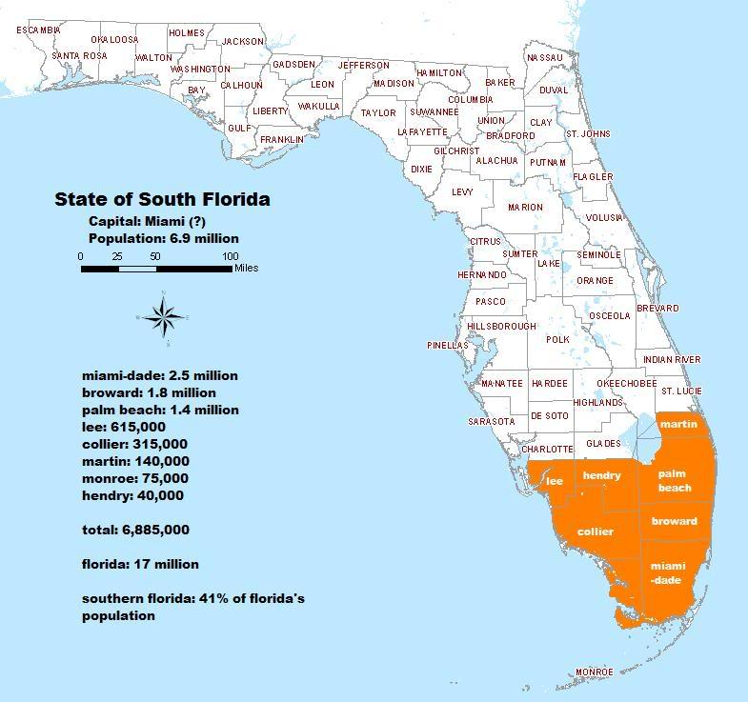
Introduction
According to our preliminary study in disaster management situations, information plays a critical role.
Based on the long and fruitful cooperation with South Florida Emergency Management and industry partners.

Slide 4
Introduction
Motivation
minimize the loss during the disaster
information explosion problem during the disaster period
deliver high-quality disaster related information
Real-time disaster information
Heterogeneous information resources
Information summarization
Diverse Information presentation

Slide 5
Introduction
Purpose
we design and implement DI-DAP, an effective disaster information delivery and analysis platform, to provide an integrated solution.
It is composed of three separated but complementary services:
- Disaster Vertical Search Engine
- Disaster Storyline Generation
- Geo-Spatial Data Analysis Portal

Slide 6
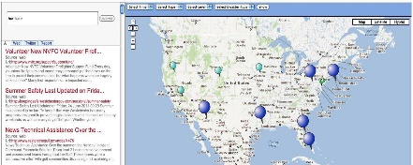
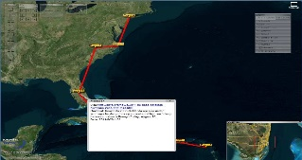
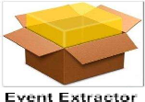
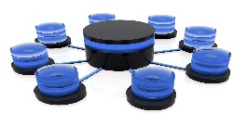
Architecture of DI-DAP
geocloud

Slide 7
Outline
Introduction
Method
Experiment
Conclusion

Slide 8
Method
Disaster Vertical Search Engine
Disaster Concept
Miami Dade Emergency Operational Center we extracted hundreds of frequent terms in its official announcements (EOC) and situation reports over the past 5 years. We assume that those terms with high frequency indicate important concepts in disaster domain.
Taxonomy Hierarchy Generation
Through careful filtering and organizing those terminologies by our staff and developers, our initial disaster taxonomy is obtained and then verified by our domain experts.

Slide 9
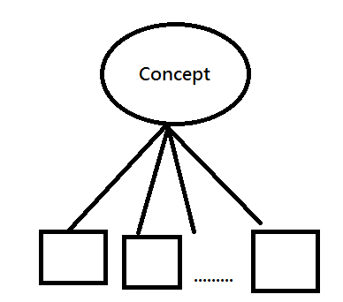
Method
Taxonomy Hierarchy Generation
T ={t1, t2, ..., tn} : All concepts in the existing taxonomy
H : the existing concept hierarchy formed by terms from T.
C = {c1, c2, ..., cm} : newly-discovered concepts are denoted as
H′: that is formed by all terms from both T and C.
each concept in T or C is represented by a set of terms extracted from the web documents repository.
H is essentially a hierarchical clustering on all documents.

Slide 10
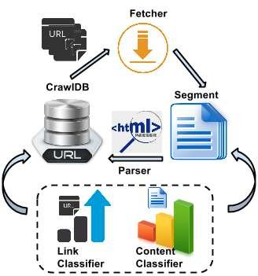
Method
Focused Crawler
Figure 2: Architecture of the focused crawler

Slide 11
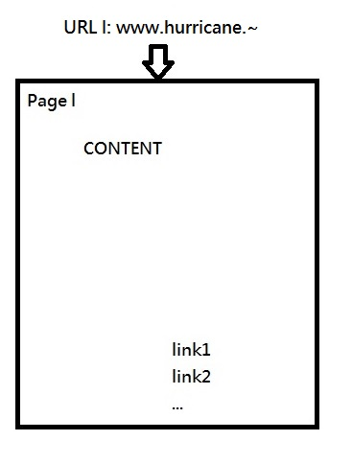
Method
To select the next page to be crawled out of all currently candidate page URLs, according to the score defined as
candidate page URLs
(link classifier)
Furthermore, to prioritize the URL l linked from page page l ,
we calculate the prioritization score as follows:
(content classifier) (link classifier)

Slide 12
Method
Disaster Storyline Engine
disaster storyline : describes how the disaster evolves over time along the location attribute of the events and how the disaster affects different areas indicated by the description attributes.
Event here denotes a tuple (t, l, s)
例如:
（08/27/2011，紐約市，“五個主要的紐約市地區的機場將取消到達的航班”）

Slide 13
Method
Event Extraction and Event Graph Construction
An event extracted Using rule-based entity recognition techniques
we select those text snippets from disaster specific documents containing
an entity type {date, location}
To remove the redundancy and obtain a set of representative events, we construct a graph G = (V, E)
the given text snippets as the vertex set V
add an edge between each pair of snippets which are likely to refer to the same event
e_{ij} =（vi，vj）∈ E > similarity threshold α

Slide 14
Method
Event Graph Construction
we use sim (v_{i}, v_{j}) to represent the similarity between two nodes v_{i}, v_{j} ∈ V shown below:

Slide 15
Method
cont_sim(·) : two nodes as the cosine similarity between their context vectors c⃗i and c⃗j.
To build the context vector, we use term frequency (TF) as the term weight and remove all the stopwords.
Note that on the text-snippet stream |Sk|, two temporally distant snippets can be very different even though they are lexically similar. [25]
< threshold δ

Slide 16
Method
Storyline Generation
the set of representative events in the original snippets with minimum redundancy
minimum dominating set (MDS)
we model the storyline generation problem
linear programming

Slide 17
Method
Having the dominating set of G(V, E)
d1, . . . , dm : m text snippets , as the representative events.
o1, o2, . . . , ol : sequence of nodes from the representative events
node-activei ∈ {0, 1} , i = 1 . . . m
next-nodei, j ∈ {0,1} , i,j = 1 . . . m , i < j
Chain Constraints:

Slide 18
Method
Length Constraints:
Location Smoothness Constraints:
D_{i,j} ∈ {0, 1} , i, j = 1, . . . , m : the distance based
A_{i,j,k} ∈ {0, 1} : triple-wise location relation-ship
Minimal Similarity Constraints:
objective function

Slide 19
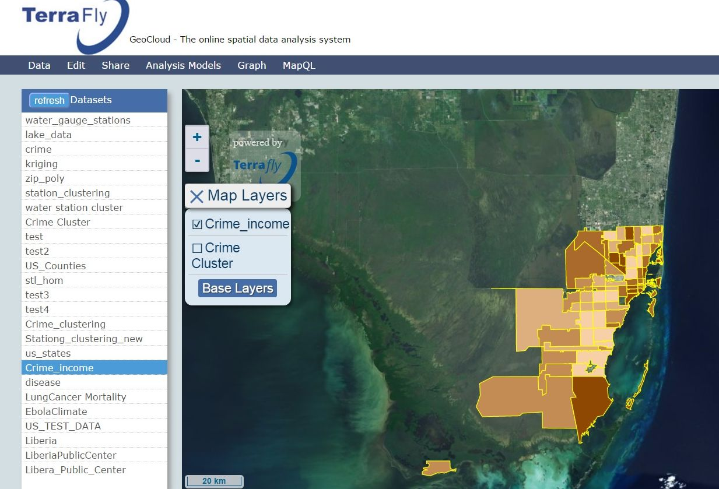
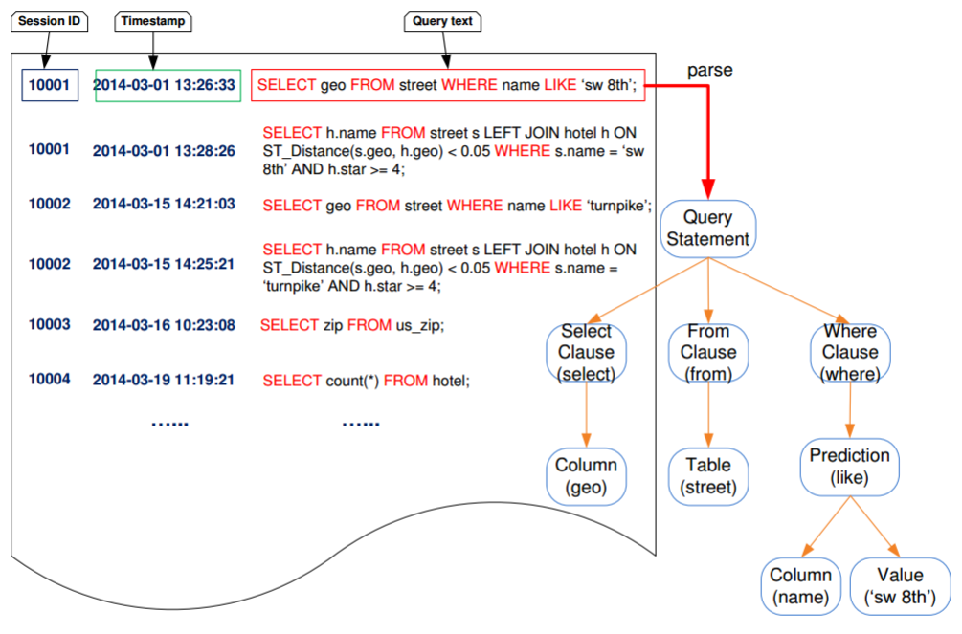
Method
Figure 3: A snippet of MapQL query logs and an example of a syntax tree for a MapQL statement
MapQL Query Template engine
Sequential Query Pattern
D = {S1，S2，...，Sn}
Si = <q1，q2，...，qi，...，qm>
T: k-subsequence of Si
T = <t1，t2，…，tk>
if support(T ) ≥ min_support
T is a sequential query pattern,

Slide 20
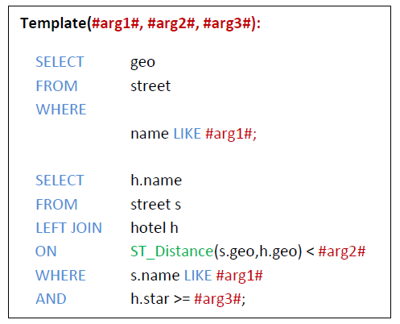
Method
Query Template
generated based on the discovered sequential query patterns.
MapQL queries can be composed by rewriting query templates.
The syntax trees in the sequential query pattern are scanned and
all the specific table, column and constant values are replaced
with their corresponding template parameters.

Slide 21
Method

Slide 22
Outline
Introduction
Method
Experiment
Conclusion

Slide 23
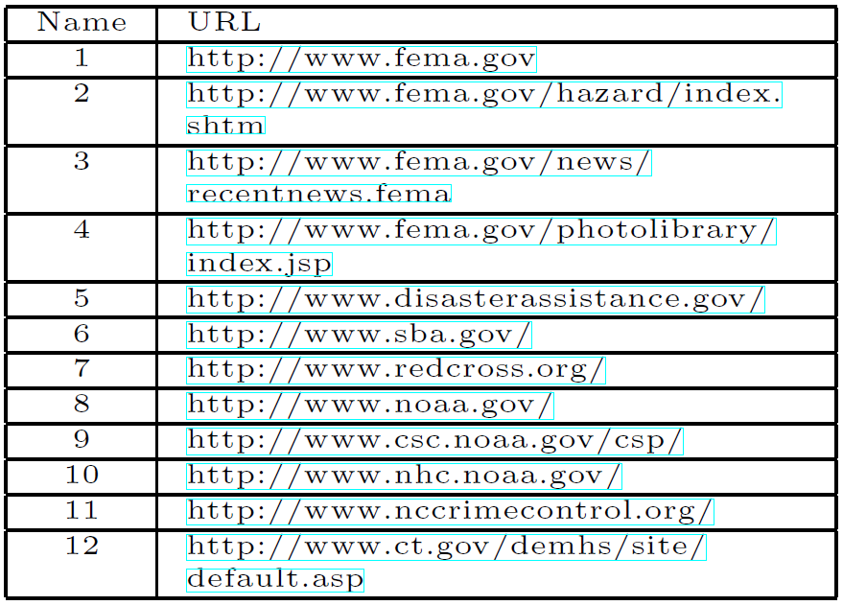
Experiment
Data Collection
In addition to the available data sources from the Miami-Dade Emergency Operation Center (EOC), South Florida Emergency Management and industry partners
we also came up with a list of websites as the seeds for our disaster crawler.
With respect to geo-spatial dataset,
TerraFly Geocloud has a rich collection of datasets
Table 1: Crawling seeds used for the focused

Slide 24
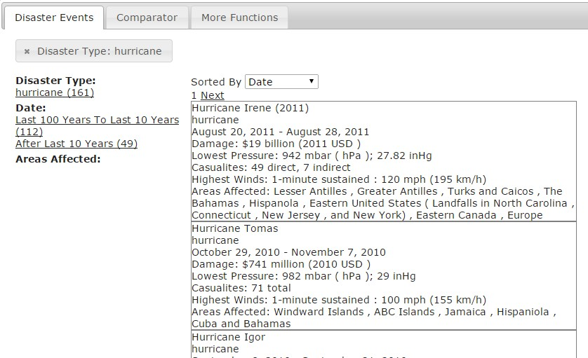
Conclusion
Vertical Search Engine Portal and Visualization
List of disaster events extracted from Wikipedia

Slide 25
Experiment
Figure 8: Experimental results of Hurricane Katrina and Irene

Slide 26
Experiment
(a) Average house property price variation during hurricane Irene
(b) Average criminal rate variation during hurricane
Figure 9: TerraFly Geo-Spatial Data Analysis

Slide 27
Outline
Introduction
Method
Experiment
Conclusion

Slide 28
Conclusion
1. This paper presents the design and implementation of DI-DAP, an efficient and effective disaster information delivery and analysis platform to address the information explosion problem during the disaster period.
2. DI-DAP supports three important services: Disaster Vertical Search Engine, Disaster Storyline Generation, and Geo-Spatial Data Analysis Portal and provide convenient and timely disaster information to the users in need.
3. DI-DAP is currently been exercised as the disaster information platform by more than 100 companies and institutions in South Florida area.

